Slide 1
Theology in Music: Listening with Heart and Mind
Passages Class
First Presbyterian Church of Charlotte
November 17, 2024

Slide 2
Listening Notes
What does the text say?
Is the piece connected to Scripture?
How does the melody change?
How does the rhythm change?
Who is singing?
What about the instruments?
Who wrote the piece?
Finally, just take in the music!

Slide 3
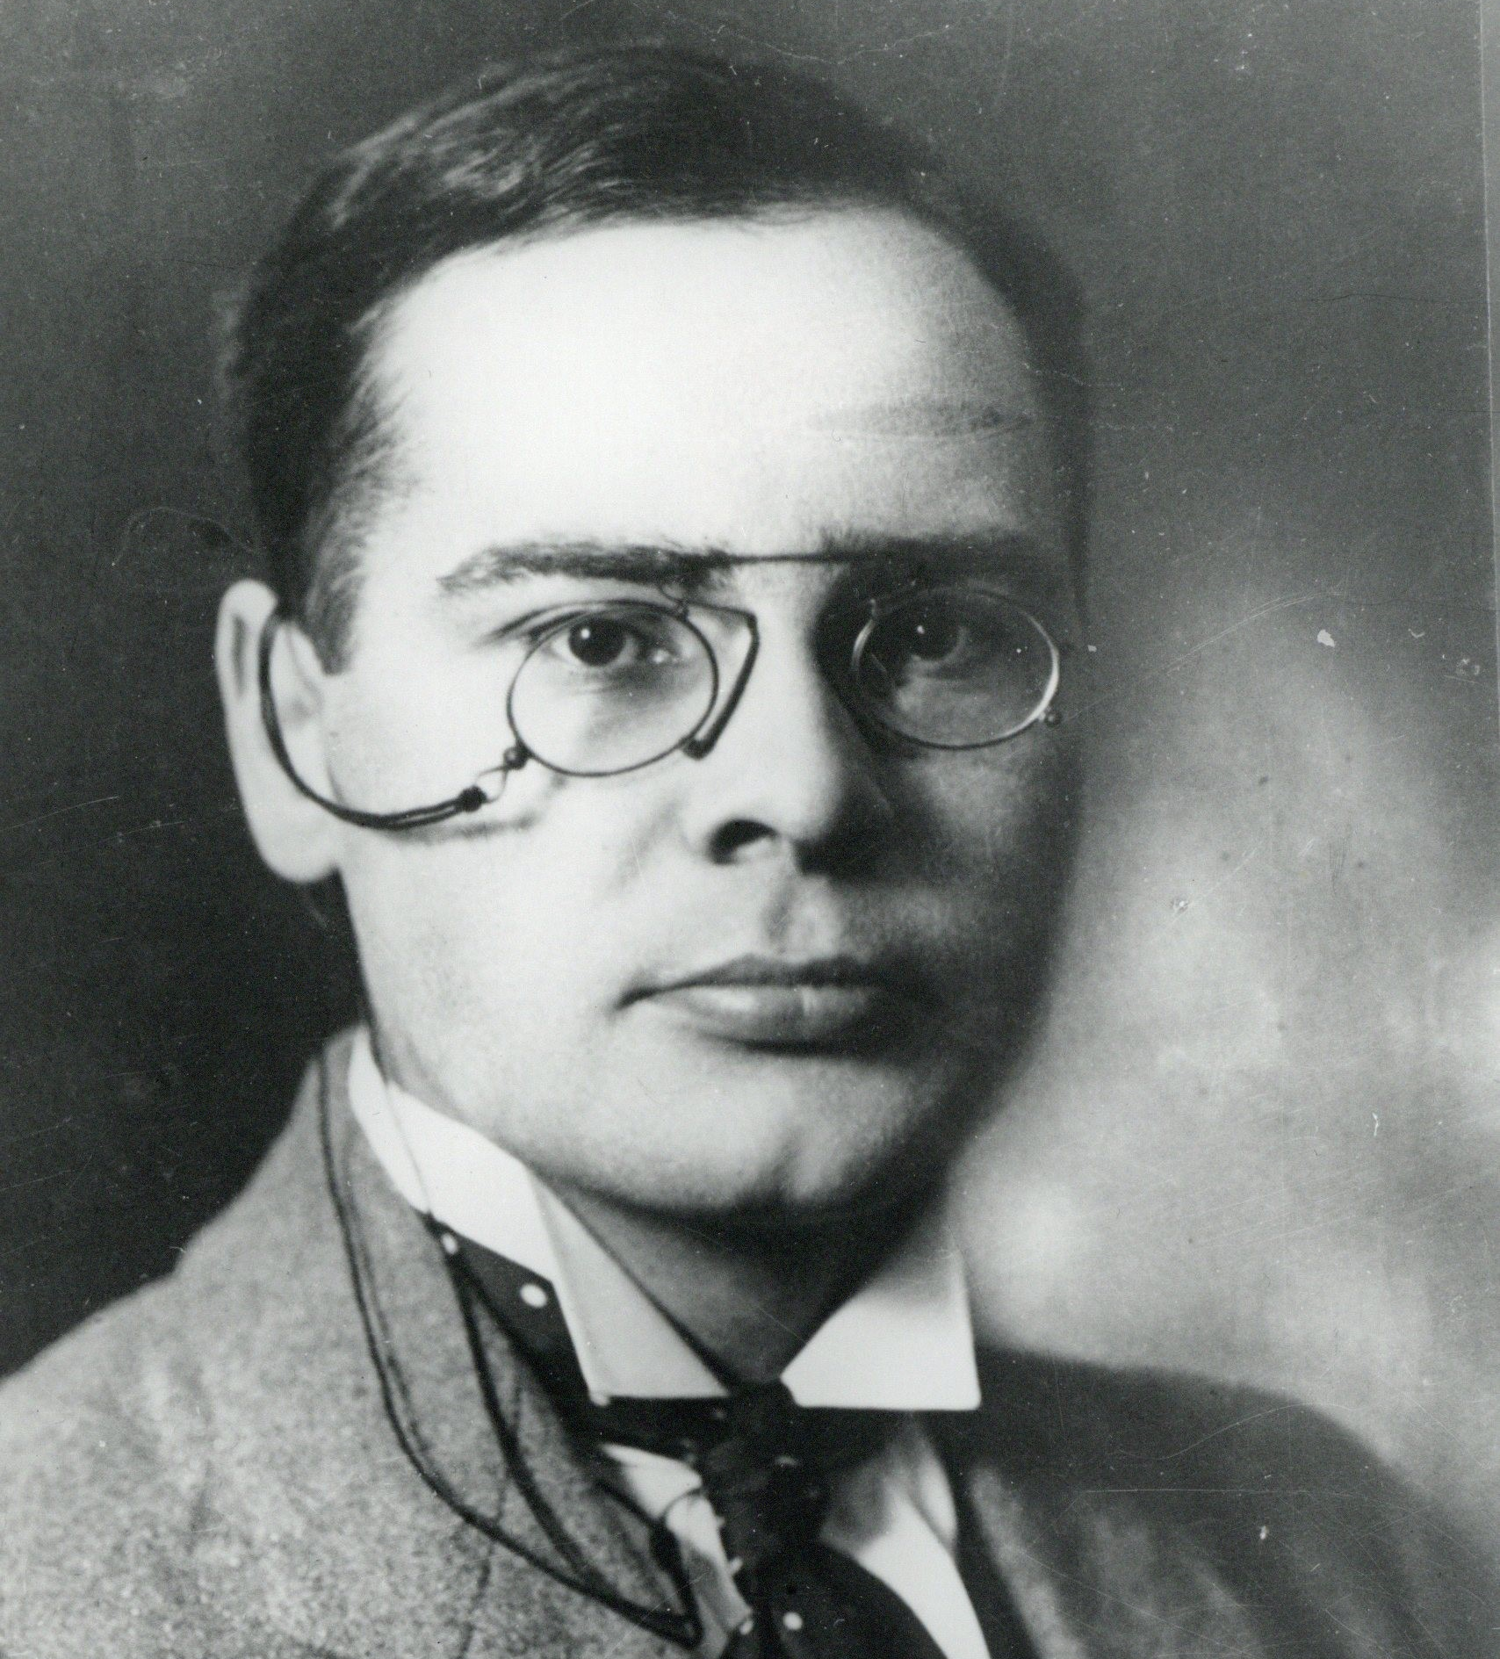
Kreek - From Heaven Above to Earth I Come
1. From Heav'n above to Earth I come To bear good news to ev'ry home; Glad tidings of great joy I bring, Whereof I will now say and sing:
2. To you this night is born a child Of Mary, chosen mother mild; This little child of lowly birth Shall be the joy of all the Earth.
3. ’Tis Christ our God, who far on high Hath heard your sad and bitter cry; Himself will your salvation be; Himself from sin will make you free.
4. He brings those blessings, long ago Prepared by God for all below; Henceforth his kindgom open stands To you, as to the angel bands.
Cyrillus Kreek (1889-1962)

Slide 4
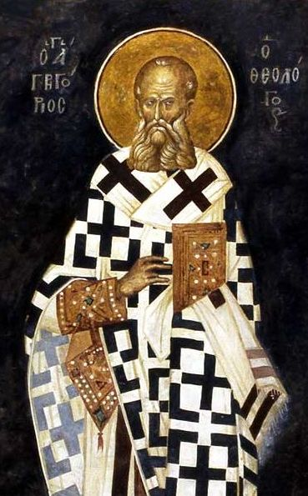
Gregory of Nazianzus (329-390)
If anyone has put his trust in Him as a Man without a human mind, he is really bereft of mind, and quite unworthy of salvation. For that which He has not assumed He has not healed; but that which is united to His Godhead is also saved. If only half Adam fell, then that which Christ assumes and saves may be half also; but if the whole of his nature fell, it must be united to the whole nature of Him that was begotten, and so be saved as a whole. Let them not, then, begrudge us our complete salvation, or clothe the Saviour only with bones and nerves and the portraiture of humanity.
But if He has a soul, and yet is without a mind, how is He man, for man is not a mindless animal? But if His Manhood is intellectual and nor without mind, let them cease to be thus really mindless. But, says such an one, the Godhead took the place of the human intellect. How does this touch me? For Godhead joined to flesh alone is not man, nor to soul alone, nor to both apart from intellect, which is the most essential part of man. Keep then the whole man, and mingle Godhead therewith, that you may benefit me in my completeness.
Epistle 101 to Cledonius the Priest Against Apollinarius

Slide 5
John 1
1 In the beginning was the Word, and the Word was with God, and the Word was God. ² He was in the beginning with God. ³ All things came into being through him, and without him not one thing came into being. What has come into being ⁴ in him was life, and the life was the light of all people. ⁵ The light shines in the darkness, and the darkness did not overtake it.
⁶ There was a man sent from God whose name was John. ⁷ He came as a witness to testify to the light, so that all might believe through him. ⁸ He himself was not the light, but he came to testify to the light. ⁹ The true light, which enlightens everyone, was coming into the world.
¹⁰ He was in the world, and the world came into being through him, yet the world did not know him. ¹¹ He came to what was his own, and his own people did not accept him. ¹² But to all who received him, who believed in his name, he gave power to become children of God, ¹³ who were born, not of blood or of the will of the flesh or of the will of man, but of God.
¹⁴ And the Word became flesh and lived among us, and we have seen his glory, the glory as of a father’s only son, full of grace and truth.

Slide 6
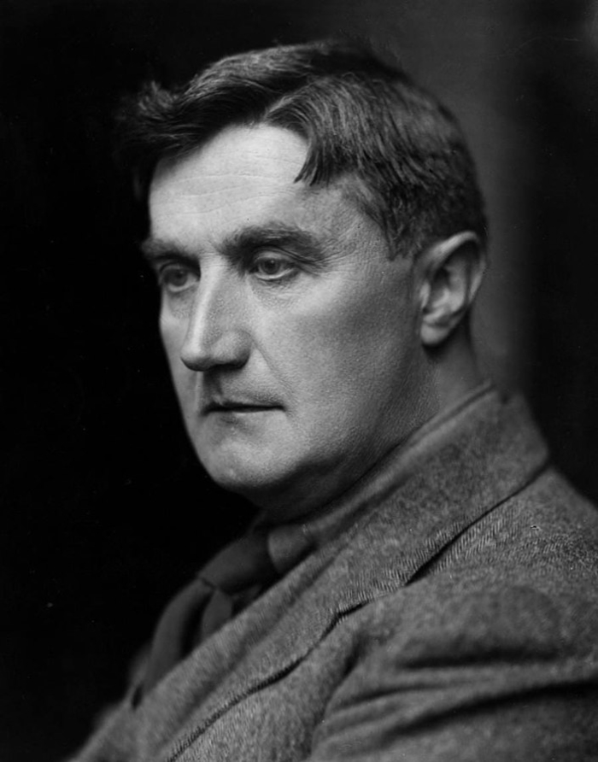
Ralph Vaughan Williams - The Lamb
Little Lamb who made thee? Dost thou know who made thee? Gave thee life and bid thee feed By the stream and o'er the mead; Gave thee clothing of delight, Softest clothing wooly bright; Gave thee such a tender voice, Making all the vales rejoice: Little Lamb who made thee? Dost thou know who made thee? Little Lamb I'll tell thee, Little Lamb I'll tell thee: He is called by thy name, For he calls himself a Lamb: He is meek and he is mild, He became a little child: I a child and thou a lamb, We are called by his name: Little Lamb God bless thee. Little Lamb God bless thee.
Ralph Vaughan Williams (1872-1958)

Slide 7
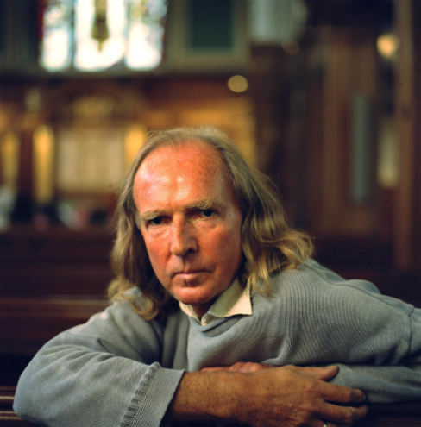
John Tavener - The Lamb
Little Lamb who made thee? Dost thou know who made thee? Gave thee life and bid thee feed By the stream and o'er the mead; Gave thee clothing of delight, Softest clothing wooly bright; Gave thee such a tender voice, Making all the vales rejoice: Little Lamb who made thee? Dost thou know who made thee? Little Lamb I'll tell thee, Little Lamb I'll tell thee: He is called by thy name, For he calls himself a Lamb: He is meek and he is mild, He became a little child: I a child and thou a lamb, We are called by his name: Little Lamb God bless thee. Little Lamb God bless thee.
John Tavener (1889-1962)

Slide 8
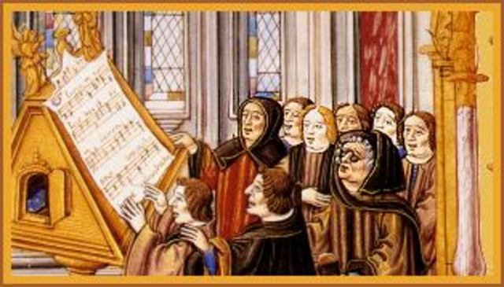
A Hymn for Compline

Slide 9
William Byrd - Christe qui lux es et dies
1. O Christ, who art the Light and Day, Thou drivest darksome night away; We know thee as the Light of light Illuminating mortal sight. 2. All holy Lord, we pray to thee, Keep us tonight from danger free; Grant us, dear Lord, in thee to rest, So be our sleep in quiet blessed. 3. Let not the tempter round us creep With thoughts of evil while we sleep, Nor with his wiles the flesh allure And make us in thy sight impure. 4. And while the eyes soft slumber take, Still be the heart to thee awake, Be thy right hand upheld above Thy servants resting in thy love.
5. Yea, our Defender, be thou nigh, To bid the powers of darkness fly; Keep us from sin, and guide for good Thy servants purchased by thy blood. 6. Remember us, dear Lord, we pray, While in this mortal flesh we stay: 'Tis thou who dost the soul defend Be present with us to the end. 7. Blest Three in One and One in Three, Almighty God, we pray to thee, That thou wouldst now vouchsafe to bless Our fast with fruits of righteousness.
William Byrd (1540-1623)

Slide 10
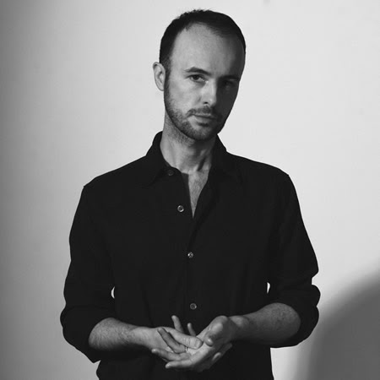
Edmund Finnis - Hymn (After Byrd)
Edmund Finnis (b. 1984)

Slide 11
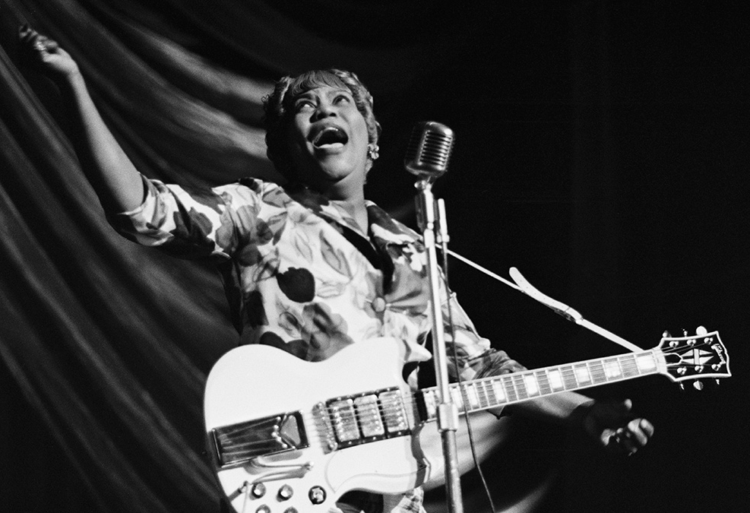
Sister Rosetta Tharpe - Didn’t It Rain
Sister Rosetta Tharpe (1910-1973)

Slide 12
Genesis 8
8 But God remembered Noah and all the wild animals and all the domestic animals that were with him in the ark. And God made a wind blow over the earth, and the waters subsided; ² the fountains of the deep and the windows of the heavens were closed, the rain from the heavens was restrained, ³ and the waters gradually receded from the earth. At the end of one hundred fifty days the waters had abated, ⁴ and in the seventh month, on the seventeenth day of the month, the ark came to rest on the mountains of Ararat. ⁵ The waters continued to abate until the tenth month; in the tenth month, on the first day of the month, the tops of the mountains appeared.
⁶ At the end of forty days Noah opened the window of the ark that he had made ⁷ and sent out the raven, and it went to and fro until the waters were dried up from the earth. ⁸ Then he sent out the dove from him to see if the waters had subsided from the face of the ground, ⁹ but the dove found no place to set its foot, and it returned to him to the ark, for the waters were still on the face of the whole earth. So he put out his hand and took it and brought it into the ark with him. ¹⁰ He waited another seven days, and again he sent out the dove from the ark, ¹¹ and the dove came back to him in the evening, and there in its beak was a freshly plucked olive leaf; so Noah knew that the waters had subsided from the earth. ¹² Then he waited another seven days and sent out the dove, and it did not return to him any more.

Slide 13
Final Notes

