Slide 1
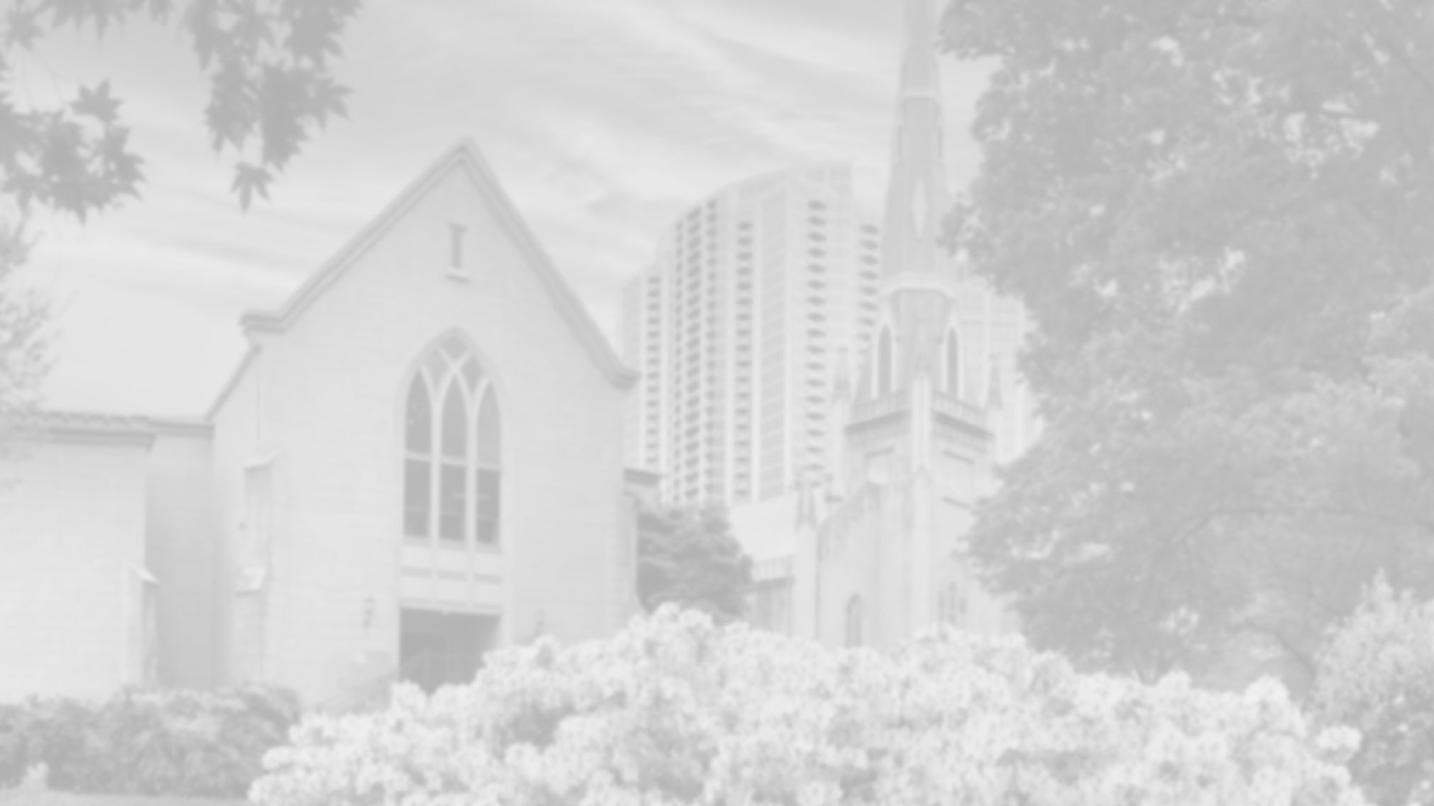
Title
Subtitle

Slide 2
Who We Are
A people of ABUNDANCE (Deuteronomy 26)
A people of SHARED HISTORY (Deuteronomy 5)
A people of PROVISION (1 Samuel 12)

Slide 3
Doesn’t mean God’s people are not part of the world.
Doesn’t mean we can’t talk/debate issues.
Doesn’t require that we agree.

Slide 4
(...it just means that what matters more than the things we agree or disagree about is our identity as God’s people)

Slide 5
Why the Old Testament?
Formative for the culture that gave birth to the church.
No less authoritative than the New Testament.
Basis for Jesus’ teaching and life

Slide 7
Deuteronomy 5:1-21
(vv. 1-3)
Moses convened all Israel, and said to them:
Hear, O Israel, the statutes and ordinances that I am addressing to you today; you shall learn them and observe them diligently. The Lord our God made a covenant with us at Horeb. Not with our ancestors did the Lord make this covenant, but with us, who are all of us here alive today.

Slide 8
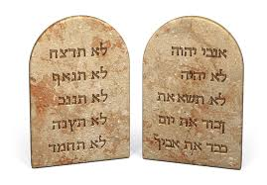

Slide 9
10 Commandments
No other Gods 5. Honor father and mother
No idols 6. No murder
No wrongful use of name 7. No adultery
Honor the Sabbath 8. No stealing
9. No false witness
10. No coveting

Slide 10
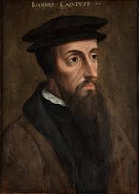
Three Uses of the Law
Serve as a mirror
Restrain evil
Show us how to live

Slide 11
https://youtu.be/p64QC00mqGs?si=tFp6hCpvx3R241cg&t=180

Slide 12
Dance Floors On Top Of…
National security concerns/tensions
Taxation
Economic inequality/insecurity
Governmental dysfunction
Tribalism
Conflict between “church and state”

Slide 13
What are Elections About?

Slide 14
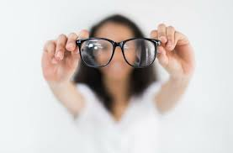
Different Lenses:
Will this benefit my neighbor?
Will it honor God?
Will it respect God’s creation?
Will it benefit future generations of God’s children?
Will it build community?
Will it protect the vulnerable?
God’s people have always shared this criteria to guide our decisions.

Slide 15
Things that Don’t Fit on the Dance Floor
Pure self-interest
Christian Nationalism
Extremism (religious or otherwise)
Racism
Lawlessness

Slide 16
Questions
How do you (personally) make imperfect choices about for whom to vote? What criteria do you use?
What is the role/place of partisanship while wearing the glasses of Scripture/God’s law?
How does it make you feel to know you make decisions based on faith when others don’t?

